Slide 1
Human Activity Recognition
Edwin Candinegara

Slide 2
Objectives
Real-time Smartphone based Human Activity Recognition
Smartwatch based Human Activity Recognition
Notes:
= Data collection process → documentation
= Activity description
Versus available data currentls

Slide 3
Data Collection
7 persons – including myself (5 males, 3 females, 19-22 years old)
Collected Data Summary:
15 activities / person
Number of Minutes:
Edwin: 89 mins
Richsen: 90 mins
Lauren: 45 mins
Shelina: 45 mins
Mellita: 45 mins
Nikolas: 45 mins
Samuel: 45 mins
Elmo: 45 mins
TOTAL: 447.5 mins

Slide 4
Baseline Results

Slide 5
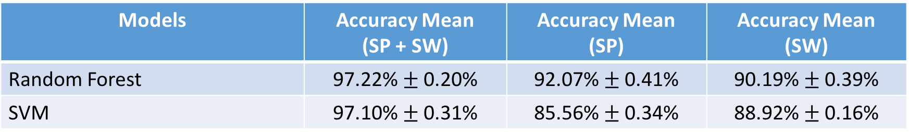
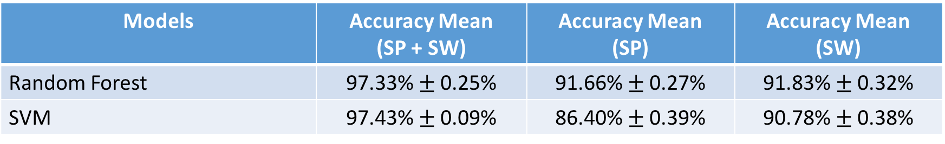
5-Fold CV on Combined Dataset (6 persons)
15 activities, Sampling @ 10 Hz, Window Size = 2s
14 activities (WITHOUT EATING), Sampling @ 10 Hz, Window Size = 2s
Models | Accuracy Mean (SP + SW) | Accuracy Mean (SP) | Accuracy Mean (SW)
Random Forest | 97.22% $±$ 0.20% | 92.07% $±$ 0.41% | 90.19% $±$ 0.39%
SVM | 97.10% $±$ 0.31% | 85.56% $±$ 0.34% | 88.92% $±$ 0.16%
Models | Accuracy Mean (SP + SW) | Accuracy Mean (SP) | Accuracy Mean (SW)
Random Forest | 97.33% $±$ 0.25% | 91.66% $±$ 0.27% | 91.83% $±$ 0.32%
SVM | 97.43% $±$ 0.09% | 86.40% $±$ 0.39% | 90.78% $±$ 0.38%

Slide 6
7 Persons Results

Slide 7
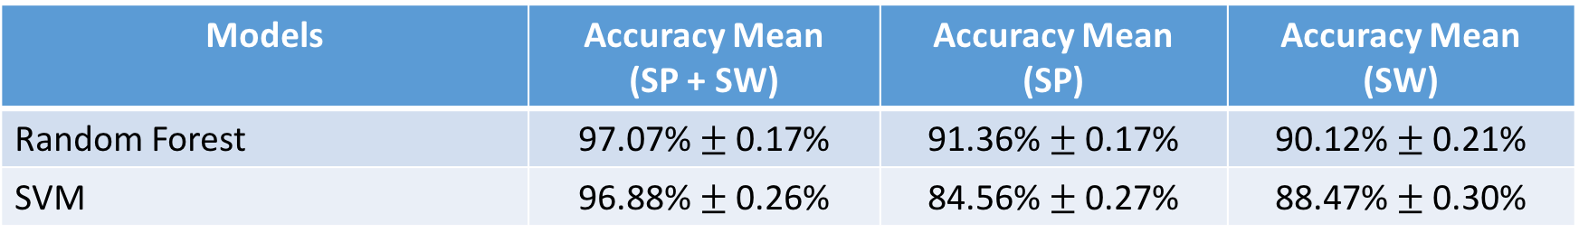
5-Fold CV on Combined Dataset (7 persons)
15 activities, Sampling @ 10 Hz, Window size = 2s
Comparison → 15 activities, 6 Persons results:
Models | Accuracy Mean (SP + SW) | Accuracy Mean (SP) | Accuracy Mean (SW)
Random Forest | 97.07% $±$ 0.17% | 91.36% $±$ 0.17% | 90.12% $±$ 0.21%
SVM | 96.88% $±$ 0.26% | 84.56% $±$ 0.27% | 88.47% $±$ 0.30%
Models | Accuracy Mean (SP + SW) | Accuracy Mean (SP) | Accuracy Mean (SW)
Random Forest | 97.22% $±$ 0.20% | 92.07% $±$ 0.41% | 90.19% $±$ 0.39%
SVM | 97.10% $±$ 0.31% | 85.56% $±$ 0.34% | 88.92% $±$ 0.16%

Slide 8
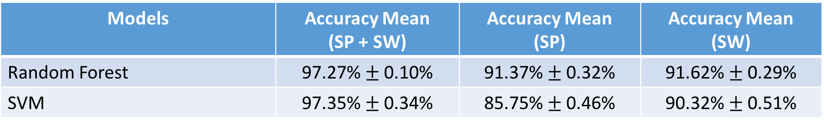
5-Fold CV on Combined Dataset (7 persons)
14 activities (WITHOUT EATING), Sampling @ 10 Hz, Window size = 2s
Comparison → 14 activities (WITHOUT EATING), 6 Persons results:
Models | Accuracy Mean (SP + SW) | Accuracy Mean (SP) | Accuracy Mean (SW)
Random Forest | 97.27% $±$ 0.10% | 91.37% $±$ 0.32% | 91.62% $±$ 0.29%
SVM | 97.35% $±$ 0.34% | 85.75% $±$ 0.46% | 90.32% $±$ 0.51%
Models | Accuracy Mean (SP + SW) | Accuracy Mean (SP) | Accuracy Mean (SW)
Random Forest | 97.33% $±$ 0.25% | 91.66% $±$ 0.27% | 91.83% $±$ 0.32%
SVM | 97.43% $±$ 0.09% | 86.40% $±$ 0.39% | 90.78% $±$ 0.38%

Slide 9
8 Persons Results

Slide 10
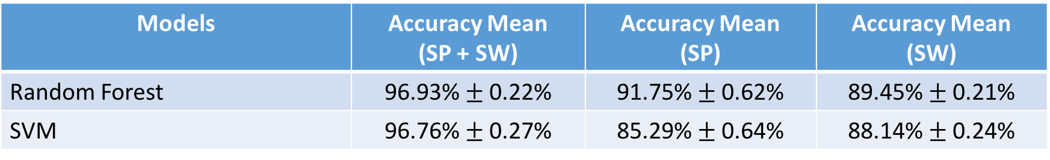
5-Fold CV on Combined Dataset (8 persons)
15 activities, Sampling @ 10 Hz, Window size = 2s
Comparison → 15 activities, 6 Persons results:
Models | Accuracy Mean (SP + SW) | Accuracy Mean (SP) | Accuracy Mean (SW)
Random Forest | 96.93% $±$ 0.22% | 91.75% $±$ 0.62% | 89.45% $±$ 0.21%
SVM | 96.76% $±$ 0.27% | 85.29% $±$ 0.64% | 88.14% $±$ 0.24%
Models | Accuracy Mean (SP + SW) | Accuracy Mean (SP) | Accuracy Mean (SW)
Random Forest | 97.22% $±$ 0.20% | 92.07% $±$ 0.41% | 90.19% $±$ 0.39%
SVM | 97.10% $±$ 0.31% | 85.56% $±$ 0.34% | 88.92% $±$ 0.16%

Slide 11
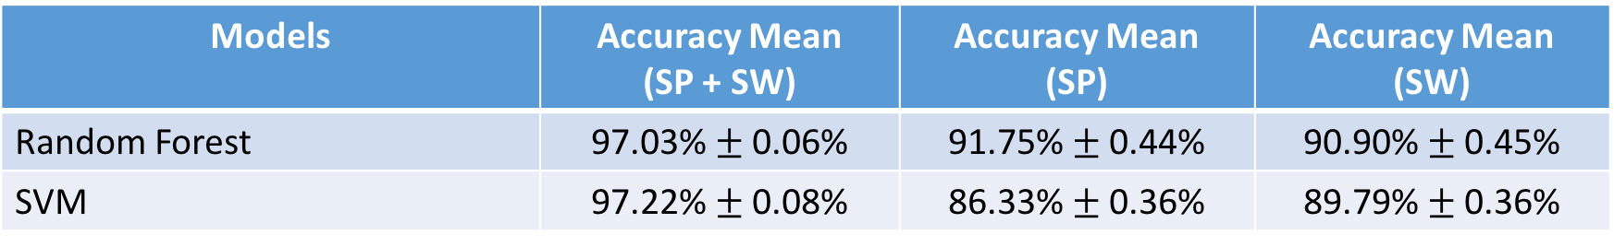
5-Fold CV on Combined Dataset (8 persons)
14 activities (WITHOUT EATING), Sampling @ 10 Hz, Window size = 2s
Comparison → 14 activities (WITHOUT EATING), 6 Persons results:
Models | Accuracy Mean (SP + SW) | Accuracy Mean (SP) | Accuracy Mean (SW)
Random Forest | 97.03% $±$ 0.06% | 91.75% $±$ 0.44% | 90.90% $±$ 0.45%
SVM | 97.22% $±$ 0.08% | 86.33% $±$ 0.36% | 89.79% $±$ 0.36%
Models | Accuracy Mean (SP + SW) | Accuracy Mean (SP) | Accuracy Mean (SW)
Random Forest | 97.33% $±$ 0.25% | 91.66% $±$ 0.27% | 91.83% $±$ 0.32%
SVM | 97.43% $±$ 0.09% | 86.40% $±$ 0.39% | 90.78% $±$ 0.38%

Slide 12
Leave One Out CV

Slide 13
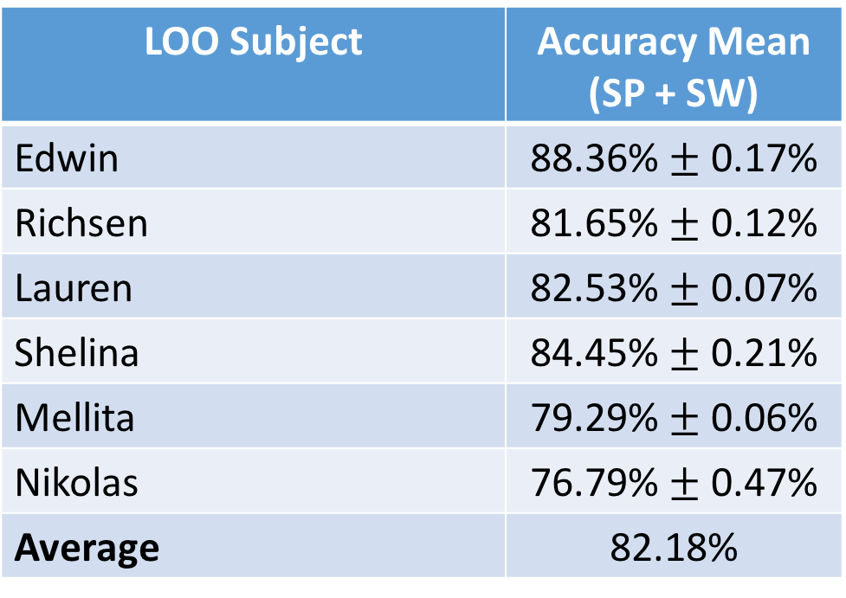
LOO (BASELINE 6 PERSONS)
14 Activities (without Eating)
Random Forest → 2000 estimators, 3 times per subject
LOO Subject | Accuracy Mean (SP + SW)
Edwin | 88.36% $±$ 0.17%
Richsen | 81.65% $±$ 0.12%
Lauren | 82.53% $±$ 0.07%
Shelina | 84.45% $±$ 0.21%
Mellita | 79.29% $±$ 0.06%
Nikolas | 76.79% $±$ 0.47%
Average | 82.18%

Slide 14
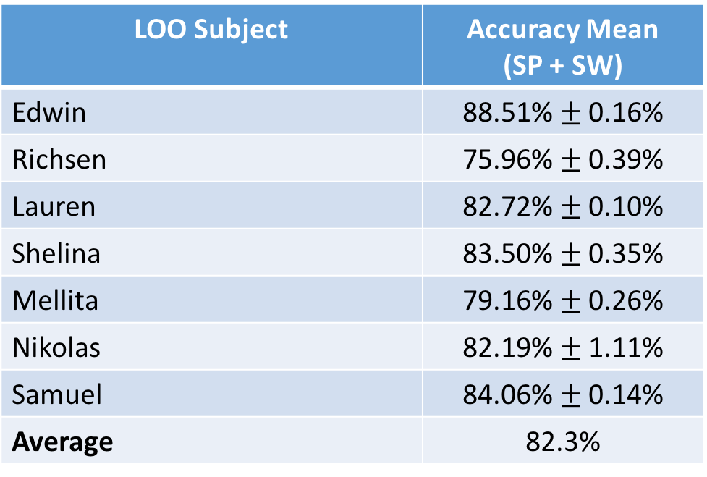
LOO (7 PERSONS)
14 Activities (without Eating)
Random Forest → 500 estimators, 3 times per subject
LOO Subject | Accuracy Mean (SP + SW)
Edwin | 88.51% $±$ 0.16%
Richsen | 75.96% $±$ 0.39%
Lauren | 82.72% $±$ 0.10%
Shelina | 83.50% $±$ 0.35%
Mellita | 79.16% $±$ 0.26%
Nikolas | 82.19% $±$ 1.11%
Samuel | 84.06% $±$ 0.14%
Average | 82.3%

Slide 15
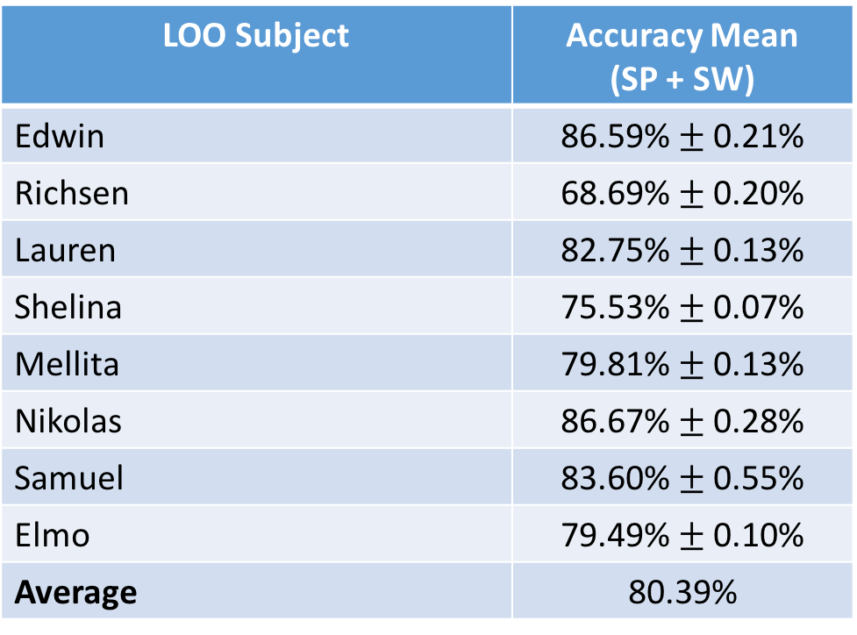
LOO (8 PERSONS)
14 Activities (without Eating)
Random Forest → 500 estimators, 3 times per subject
LOO Subject | Accuracy Mean (SP + SW)
Edwin | 86.59% $±$ 0.21%
Richsen | 68.69% $±$ 0.20%
Lauren | 82.75% $±$ 0.13%
Shelina | 75.53% $±$ 0.07%
Mellita | 79.81% $±$ 0.13%
Nikolas | 86.67% $±$ 0.28%
Samuel | 83.60% $±$ 0.55%
Elmo | 79.49% $±$ 0.10%
Average | 80.39%

Slide 16
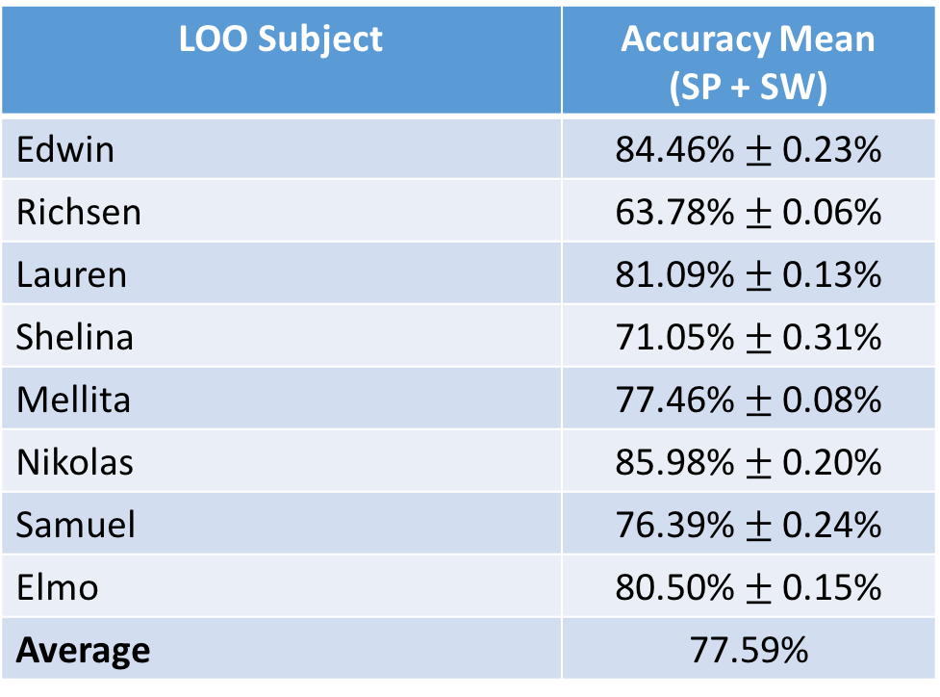
LOO (8 PERSONS)
15 Activities
Random Forest → 500 estimators, 3 times per subject
LOO Subject | Accuracy Mean (SP + SW)
Edwin | 84.46% $±$ 0.23%
Richsen | 63.78% $±$ 0.06%
Lauren | 81.09% $±$ 0.13%
Shelina | 71.05% $±$ 0.31%
Mellita | 77.46% $±$ 0.08%
Nikolas | 85.98% $±$ 0.20%
Samuel | 76.39% $±$ 0.24%
Elmo | 80.50% $±$ 0.15%
Average | 77.59%

Slide 17
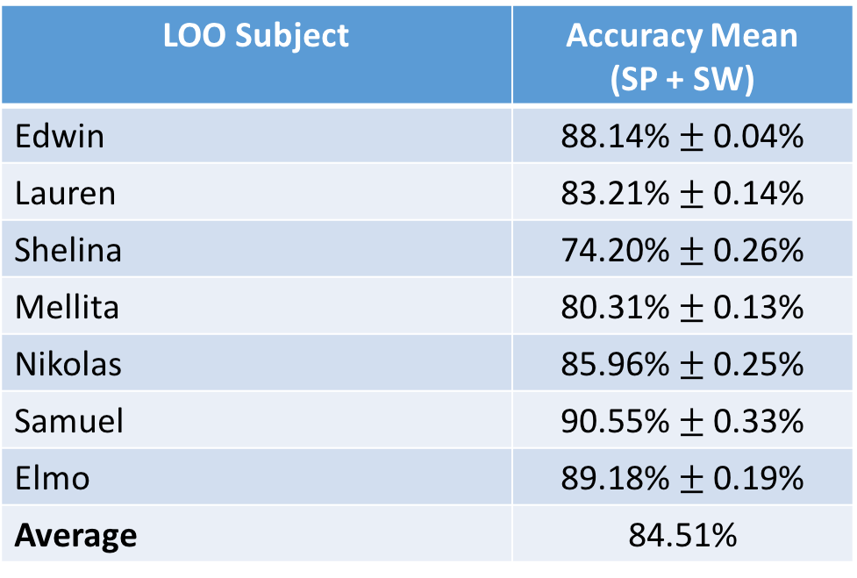
LOO (7 PERSONS – without Richsen)
14 Activities (without Eating)
Random Forest → 500 estimators, 3 times per subject
LOO Subject | Accuracy Mean (SP + SW)
Edwin | 88.14% $±$ 0.04%
Lauren | 83.21% $±$ 0.14%
Shelina | 74.20% $±$ 0.26%
Mellita | 80.31% $±$ 0.13%
Nikolas | 85.96% $±$ 0.25%
Samuel | 90.55% $±$ 0.33%
Elmo | 89.18% $±$ 0.19%
Average | 84.51%

Slide 18
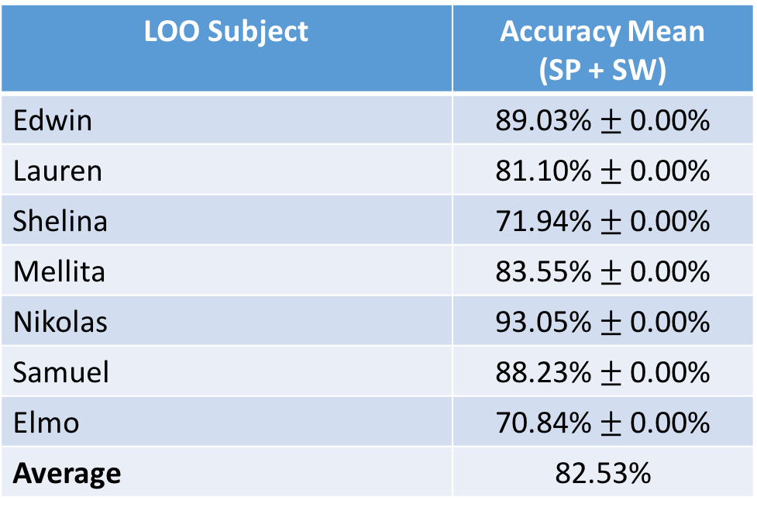
LOO (7 PERSONS – without Richsen)
14 Activities (without Eating)
SVM → C = 1, Gamma = 0.5, 3 times per subject
LOO Subject | Accuracy Mean (SP + SW)
Edwin | 89.03% $±$ 0.00%
Lauren | 81.10% $±$ 0.00%
Shelina | 71.94% $±$ 0.00%
Mellita | 83.55% $±$ 0.00%
Nikolas | 93.05% $±$ 0.00%
Samuel | 88.23% $±$ 0.00%
Elmo | 70.84% $±$ 0.00%
Average | 82.53%

Slide 19
Other Observations (7 Persons without Richsen)
Typing vs Writing (Lauren)
Lying vs Reading (Elmo, Shelina)
Sitting vs Reading (Mellita, Edwin)
Going downstairs vs Going upstairs vs Walking (Mellita, Elmo, Shelina)
Sitting vs Lying (Nikolas)
Hypothesis:
Probably because of which features are being used in splitting the trees
If we only use SP data, then Lying and Sitting can be recognized
When only use SW data, all Lying becomes Sitting (or the other way round)
So, when we use SP + SW, most likely the decision trees do not really make use of the SP data

Slide 20
LOO with XYZ Permutations (7 PERSONS)
14 Activities (without Eating)
Random Forest → result is very bad (tested on 2 subjects with different parameter values), as low as ~12% accuracy!
SVM → result is also very bad (tested on 2 subjects), < 10% accuracy
Hence, I did not do a full testing:
The results for a few test subjects are very bad
The training time is very long as the data is augmented resulting in around 6 times bigger than the usual one
This method also seems not scalable with more test subjects without using a more powerful computer to train the model!

